Slide 1

ASI322 - Big DATA
Twitter World Cup Analysis
Kazem Julien Ammar
Thibaut Sagnard
Notes:
Photo by Sean Pollock on Unsplash

Slide 2





Phase 1 : Data Collection

Slide 3




Phase 2: Data Processing

Slide 4


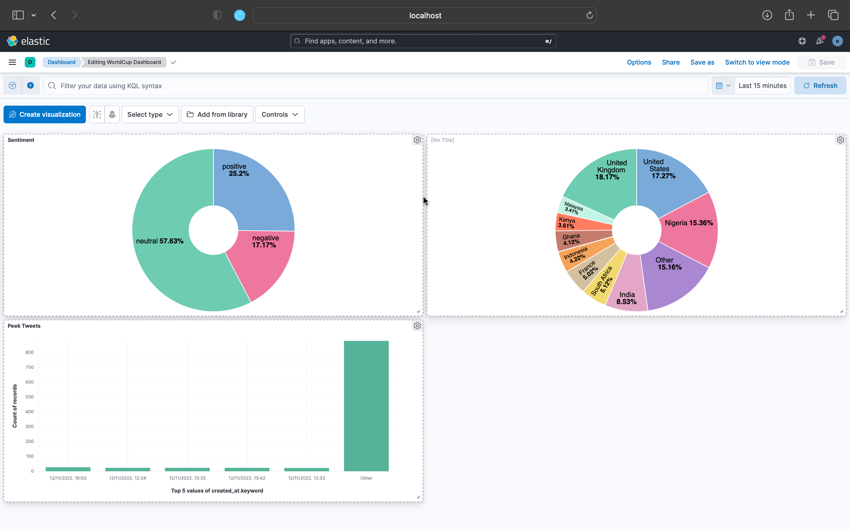

Phase 3: Data Visualization

Slide 5
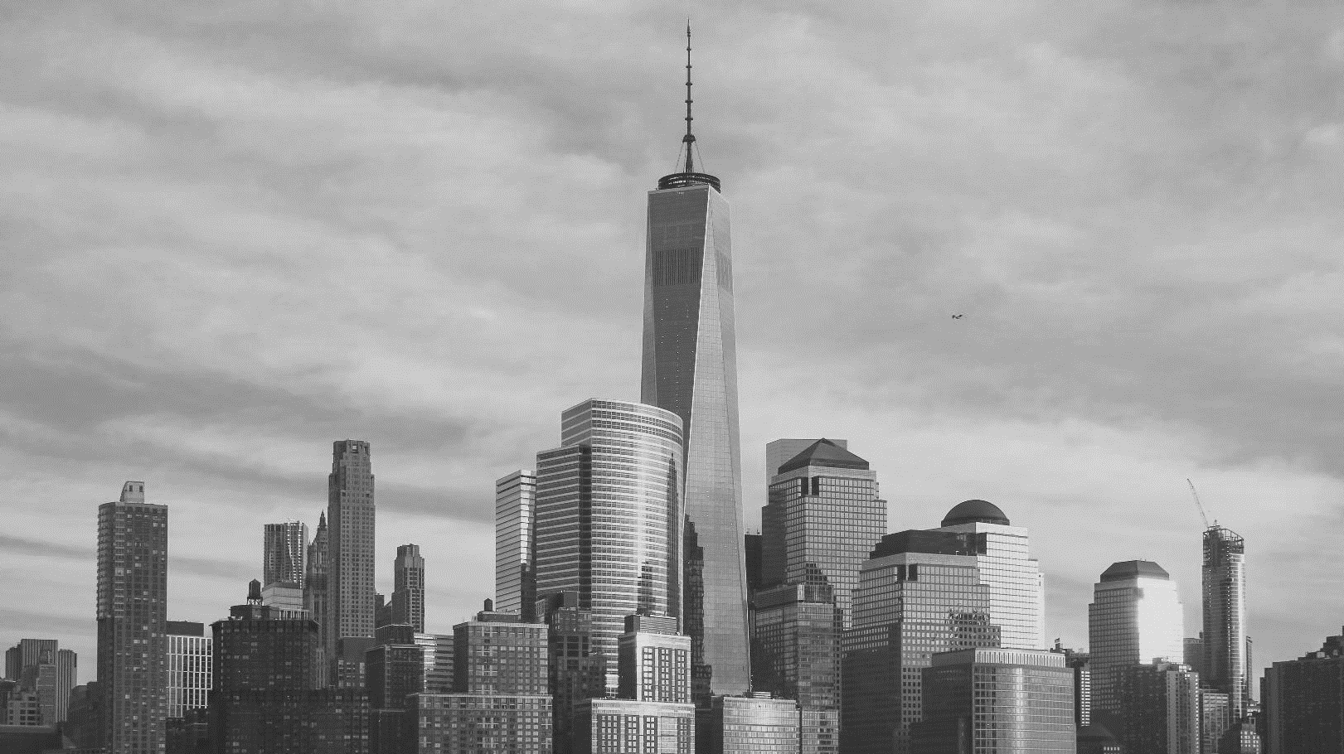
THANK YOU

